Slide 1
Thermodynamics Lecture 02
Basic Mechanical Engineering

Slide 2
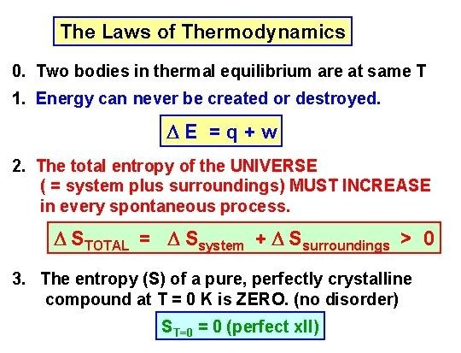
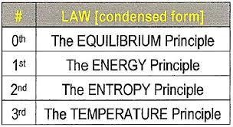
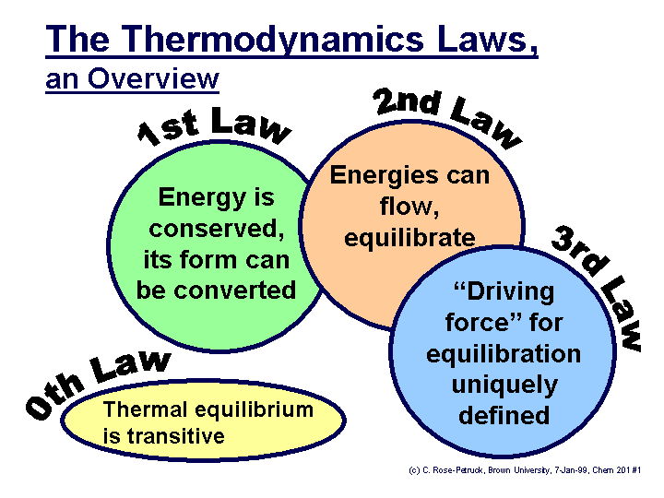
A Quick Review:
BME lecture final ter
m week:1

Slide 3
THERMODYNAMICES
THERMO--- Heat Released
DYNAMICS ----- Mechanical Action For doing work
The study of the effects of work, heat flow, and energy on a system
Movement of thermal energy
Engineers use thermodynamics in systems ranging from nuclear power plants to electrical components.
Thermodynamics is the study of the effects of work, heat, and energy on a system
Thermodynamics is only concerned with macroscopic (large- scale) changes and observations

Slide 4
SYSTEM, SURROUNDING ,UNIVERSE
SYSTEM-Area under thermodynamic study
SURROUNDING – Area outside the system
Surface/Layer/Partition
BOUNDARY- | System | & Surrounding | are
separated by | some | Imaginary Or | real
UNIVERSE – System & together is called Universe
Surroundings put

Slide 5

ISOLATED, CLOSED AND OPEN SYSTEMS
4
Isolated System
Neither energy nor mass can be exchanged.
E.g. Thermo flask
Closed System
Energy, but not mass can be exchanged.
E.g. Cylinder filled with gas & piston
Open System
Both energy and mass can be exchanged.
E.g. Gas turbine, I.C. Engine

Slide 6
THERMODYNAMIC PROPERTIES
Thermodynamic Properties – It is measurable & Observable characteristics of the system.
Extensive: Depend on mass/size of system (Volume [V]), Energy
Intensive: Independent of system mass/size (Pressure [P], Temperature [T])
Specific: Extensive/mass (Specific Volume [v])

Slide 7
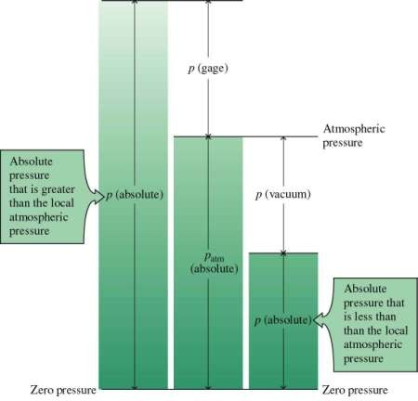
PRESSURE
PRESSURE
PRESSURE
P = Force/Area
Pa, Kpa,Bar, N/m²
Types:
Absolute
Gage (Vacuum)
Atmospheric
^{P}abs ^{=P}atm ^{+/- P}gauge

Slide 8
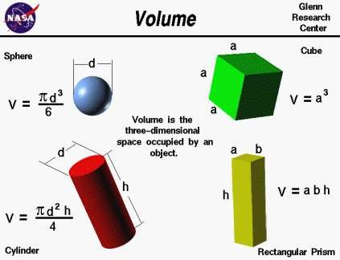
Volume
Volume
Volume
Three dimensional space occupied by an object
Unit- M³ , Liter 1 m³ = 10³ lit

Slide 9
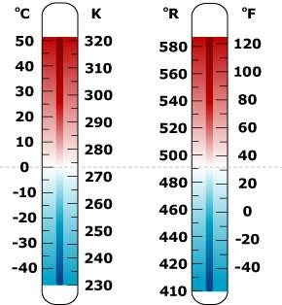
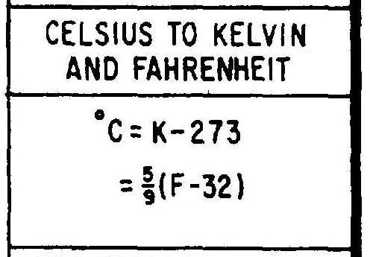
Temperature
Temperature
Temperature Scale
Quantitative indication of Degree of Hotness & coldness of the body.
Unit- ⁰C , K , F
Thermometer
Thermometry

Slide 10
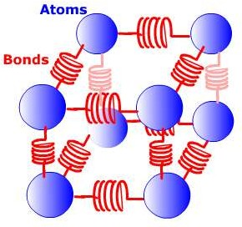
Internal energy
Internal Energy
Internal Energy [U]
Internal energy (also called thermal energy) is the energy an object or substance is due to the kinetic and potential energies associated with the random motions of all the particles that make it up.
Internal energy is defined as the energy associated with the random, disordered motion of molecules.
Unit- KJ , Joule

Slide 11
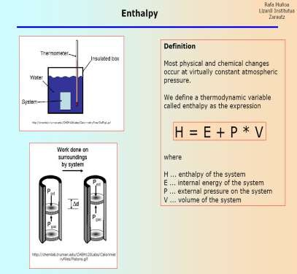
Enthalpy
Enthalpy
Enthalpy
Total Heat content of Body
Heat supplied to the body Enthalpy increases & decreases when heat is removed
Enthalpy is a measure of the total energy of a thermodynamic system.

Slide 12
Work
Work = Force x Displacement (Nm) ( Joule)
Energy in Transient
Path function
High grade energy
Work done by the system on the surrounding
-Positive work
Work done on the system by surrounding – Negative work

Slide 13
HEAT
Energy transfer by virtue of temperature difference
Transient form of energy
Path function
Low grade energy
Negative heat- heat transferred from the system ( heat rejection)
Positive heat – heat transferred from surrounding to system (heat absorption)

Slide 14



HEAT
HEAT
CONCEPT
Energy transfer by virtue of temperature difference
Transient form of energy
Path function
Low grade energy
Negative heat- heat transferred from the system ( heat rejection)
Positive heat – heat transferred from surrounding to system (heat absorption)
hot
heat
cold
26 °C
26 °C

Slide 15
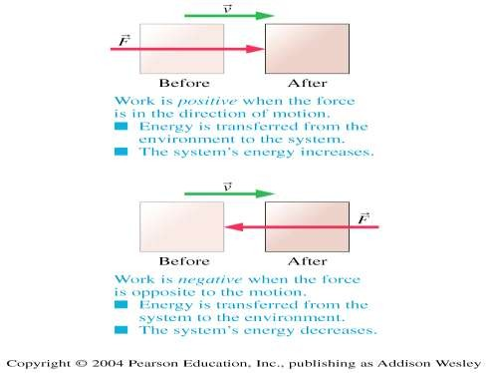
Work & Heat
WORK
WORK
Work is the energy transferred between a system and environment when a net force acts on the system over a distance.
The sign of the work
Work is positive when the force is in the direction of motion
Work is negative when the force is opposite to the motion

Slide 16
LAWS OF THERMODYNAMICS
FIRST LAW OF THERMODYNAMICS (LAW OF ENERGY CONSERVATION)
SECOND LAW OF THERMODYNAMICS
ZEROTH LAW OF THERMODYNAMICS

Slide 17
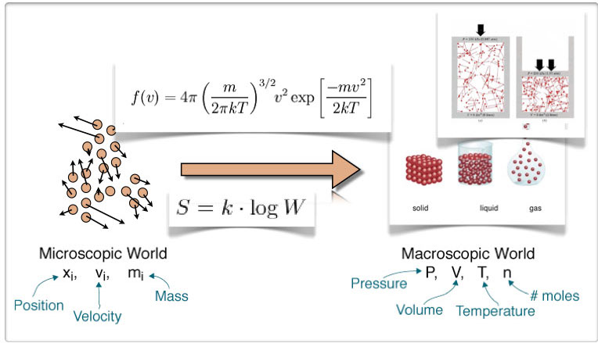

Slide 18
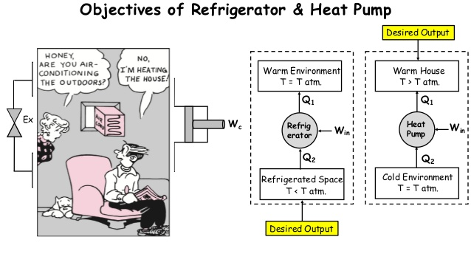
Heat Engine, Heat Pump & Refrigerator:

Slide 19
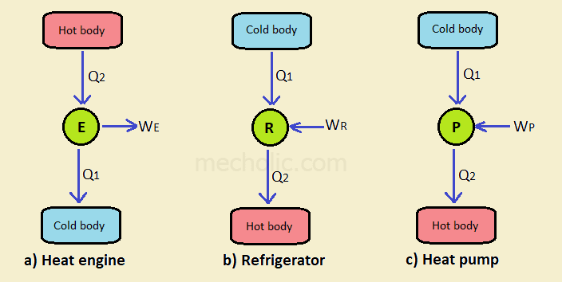
Comparison:

Slide 20
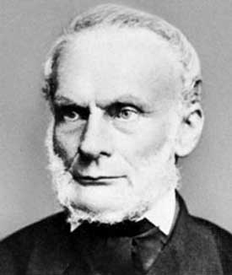
Rudolf Clausius
Name: Rudolf Julius Emanuel Clausius (2 January 1822 – 24 August 1888) was a German physicist and mathematician and is considered one of the central founders of science of thermodynamics. By his restatement of Sadi Carnot's principle known as the Carnot cycle, he gave the theory of heat a truer and sounder basis. His most important paper, "On the Moving Force of Heat", published in 1850, first stated the basic ideas of the 2nd law of thermodynamics. In 1865 he introduced the concept of entropy. In 1870 he introduced the virial theorem which applied to heat.

Slide 21
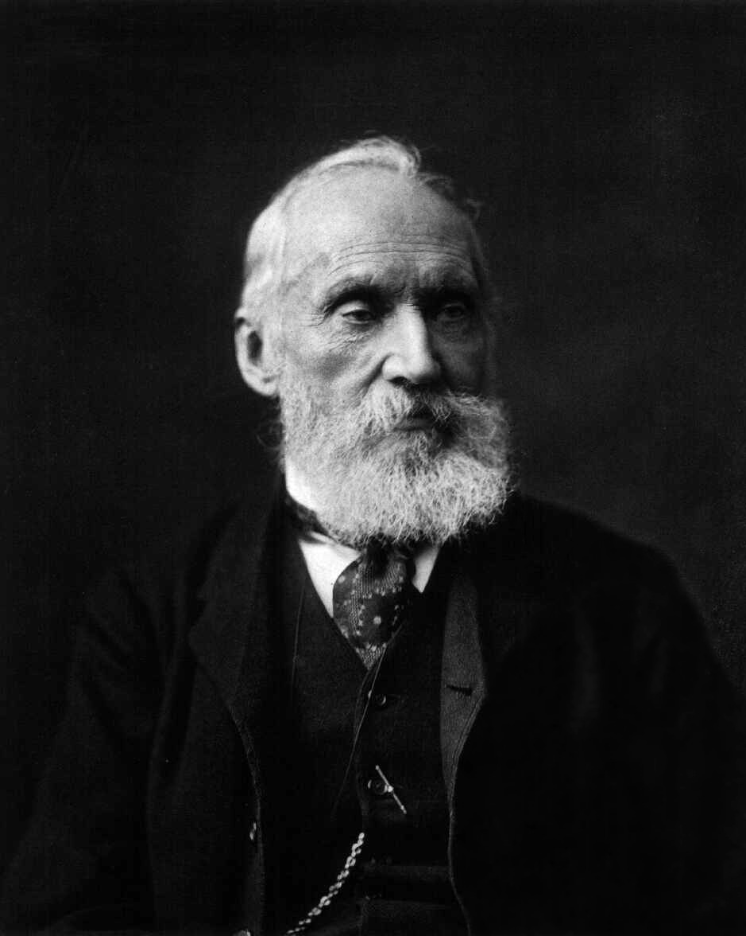
William Thomson, 1st Baron Kelvin
Sir William Thomson, 1st Baron Kelvin, (26 June 1824 – 17 December 1907) was an Irish-Scottish (of Ulster Scots heritage) mathematical physicist and engineer who was born in Belfast in 1824. At the University of Glasgow he did important work in mathematical analysis of electricity and formulation of 1st & 2nd laws of thermodynamics and did much to unify the emerging discipline of physics in its modern form.

Slide 22
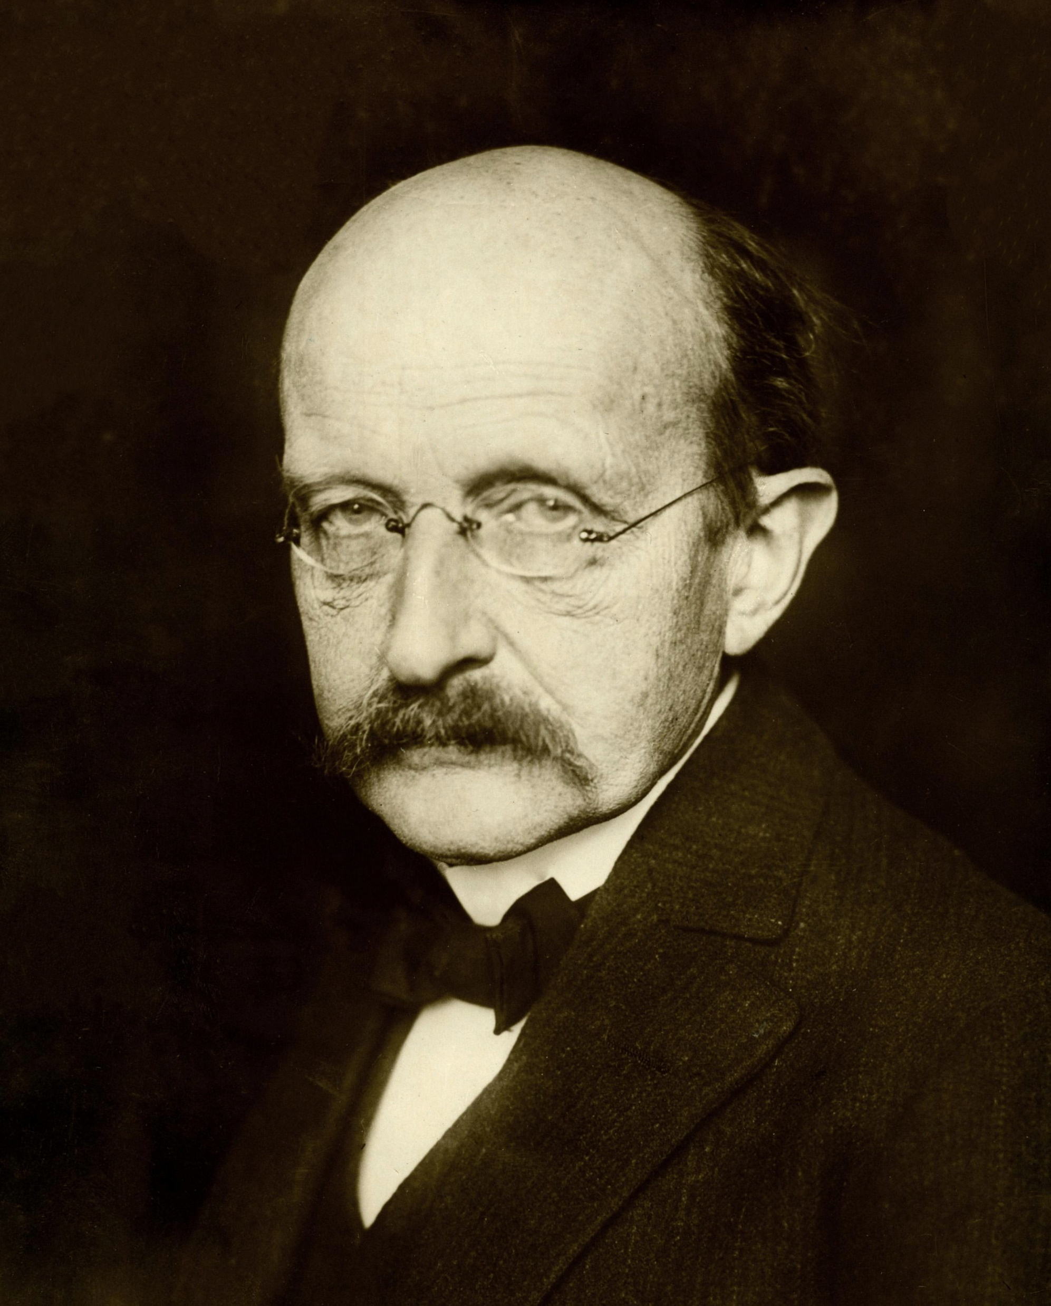
Max Planck
Max Karl Ernst Ludwig Planck (23 April 1858 – 4 October 1947) was a German theoretical physicist whose discovery of energy quanta won him the Nobel Prize in Physics in 1918.
Mostly famous for discovering Albert Einstein and formulating: E = h (f), h = Planck’s constant.

Slide 23
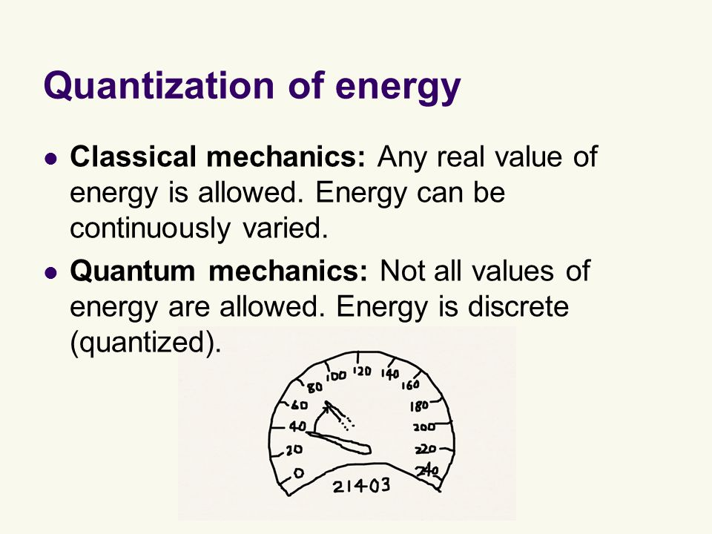

Slide 24
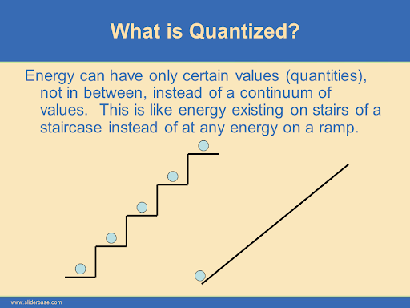

Slide 25
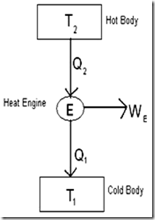
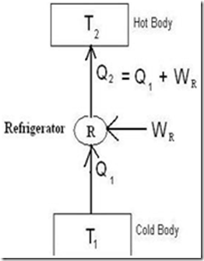
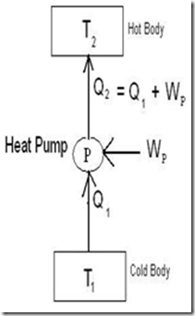
Comparison:

Slide 26
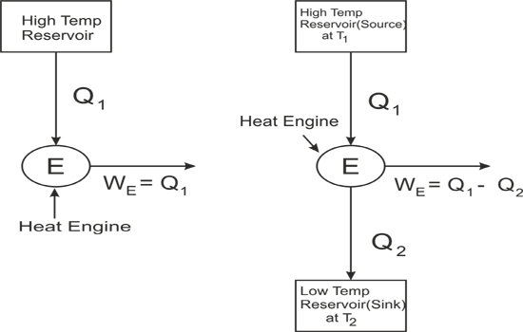
Kelvin Planck Statement:
The Kelvin–Planck statement (or the Heat Engine Statement) of the second law of thermodynamics states that it is impossible to devise a cyclically operating heat engine, the effect of which is to absorb energy in the form of heat from a single thermal reservoir and to deliver an equivalent amount of work. This implies that it is impossible to build a heat engine that has 100% thermal efficiency.

Slide 27
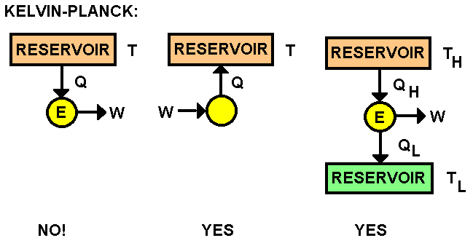

Slide 28
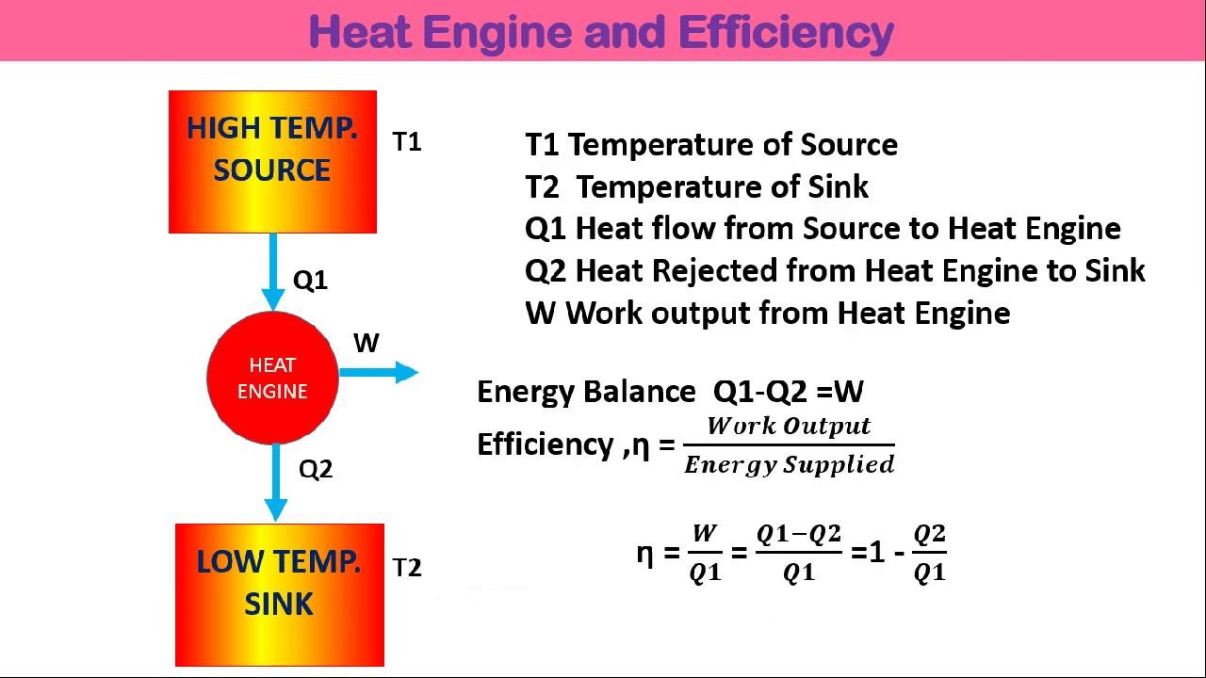

Slide 29
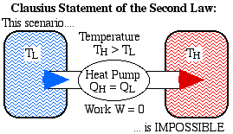
Clausius Statement:
It is impossible for heat to move by itself from a lower temperature reservoir to a higher temperature reservoir. That is, heat transfer can only occur spontaneously in the direction of temperature decrease. For example, we cannot construct a refrigerator that operates without any work input.

Slide 30
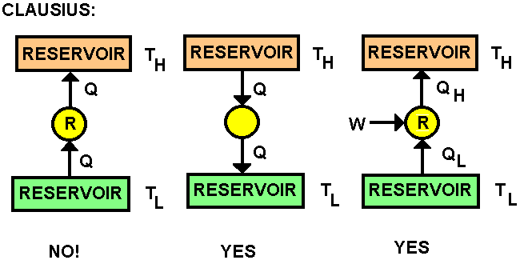

Slide 31
Why work can be completely converted into heat but not vice versa?
Whenever we want to convert work to heat even the efficiency losses like friction will also dissipates as Heat. So, there must be no losses because even losses are converting to heat energy.
But this will not happen while converting heat to work. Because the losses are also dissipated as Heat. Means some of heat energy is lost during this process. So, we can't convert heat completely in to work.
Lost means it can’t be converted into a form to perform useful work.
Hence, the entropy of the universe in every moment is increasing.
While there is no limit to the ability to convert work to heat, there is a limit on converting heat to work, as the minimum temperature can be only low as – 273°C but not lower than that.

Slide 32
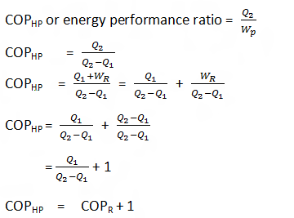
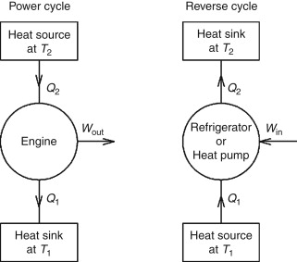
C.O.P.

Slide 33
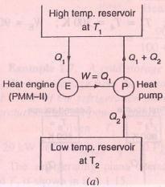
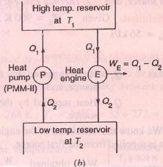
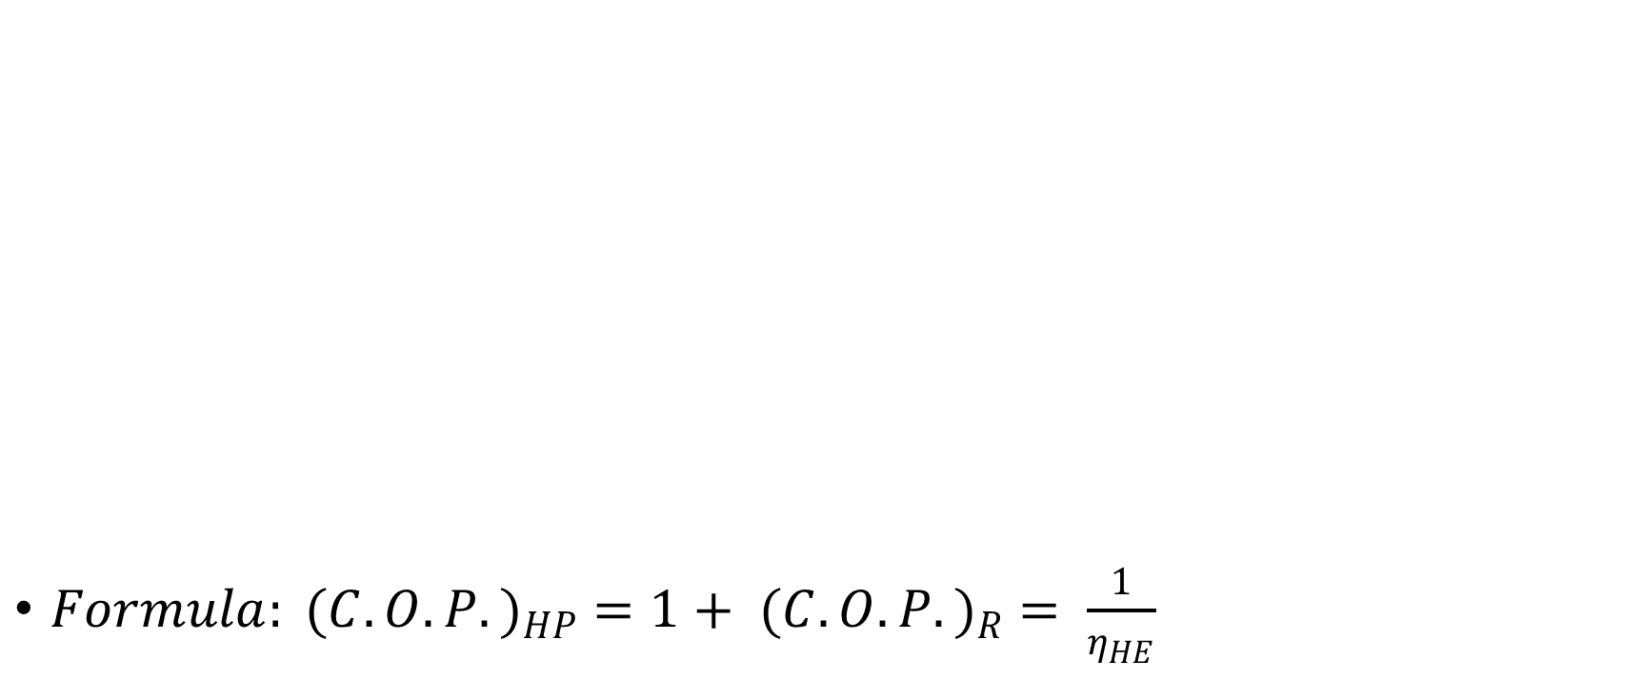
Equivalence of Kelvin Plank and Clausius Statement
$Formula: {(C.O.P.)}_{HP} =1+ {(C.O.P.)}_{R} = \frac{1}{η_{HE}}$

Slide 34

Perpetual Motion Machine of First Kind

Slide 35

Perpetual Motion Machine of Second Kind
Why doesn't this work?
Can anyone explain???

Slide 36
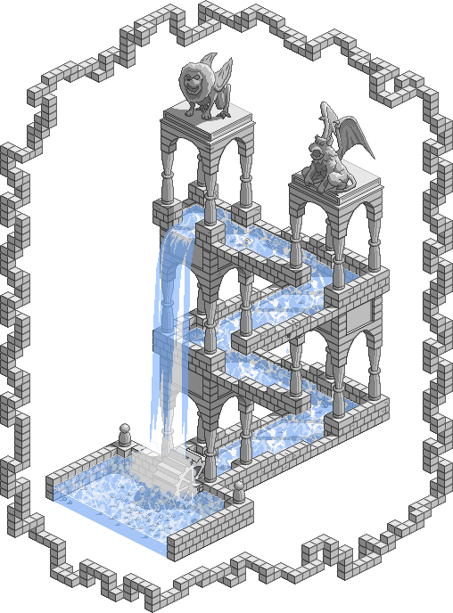
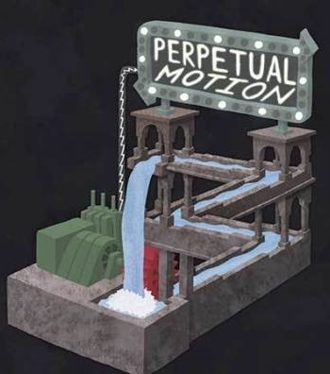
Perpetual Motion Machine of Third Kind

Slide 37
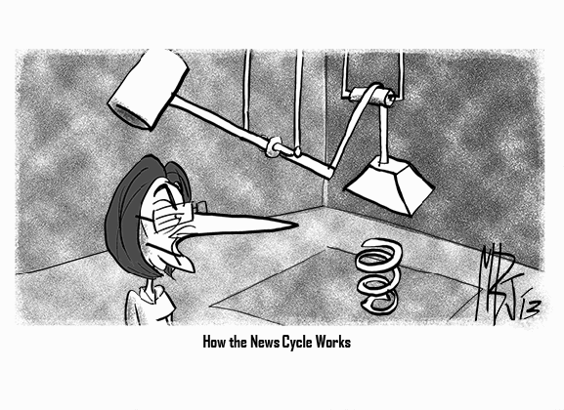
Pop Quiz: What kind of PMM is this one?

Slide 38


Slide 39
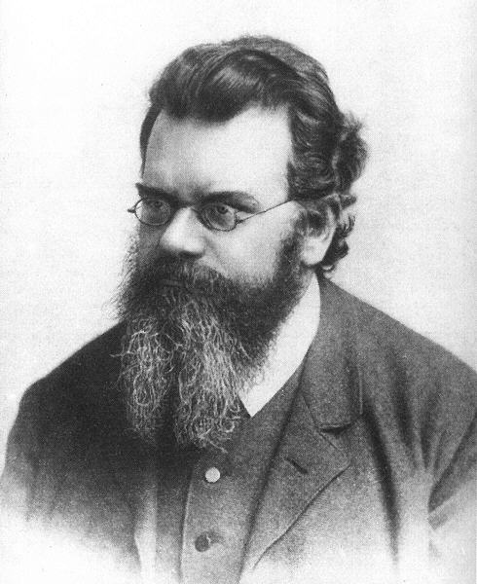
Ludwig Eduard Boltzmann (German; February 20, 1844 – September 5, 1906) was an Austrian physicist and philosopher. His greatest achievement was in the development of statistical mechanics, which explains and predicts how the properties of atoms (such as mass, charge, and structure) determine the physical properties of matter (such as viscosity, thermal conductivity, and diffusion). Boltzmann coined the word ergodic while he was working on a problem in statistical mechanics.
TASK:
What is Boltzmann Brain?
What is Boltzmann Demon?
What is Boltzmann Constant?

Slide 40
Q = mcΔt
Q – Energy (Heat gained or lost)
m – Mass
c – Specific Heat
Δt – Change in Temperature
Q
m c Δt

Slide 41
HEAT RESERVOIR, HEAT SOURCE, HEAT SINK
HEAT RESERVOIR- Source of infinite heat energy & finite amount of heat addition & heat rejection from it will not change its temperature
E. g. Ocean, River, Large bodies of water Lake
HEAT SOURCE- Heat reservoirs which supplies heat to system is called heat source
HEAT SINK- Heat reservoir which receives absorbs heat from the system

Slide 42
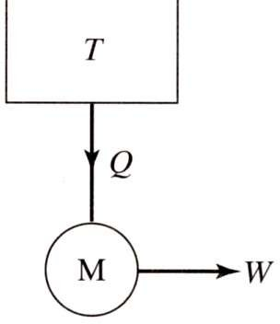
2ND LAW OF THERMODYNAMICS
KELVIN –PLANCK’S STATEMENT
It is impossible to construct a machine which operates in cycle whose sole effect is to
convert equivalent work
heat into amount of

Slide 43
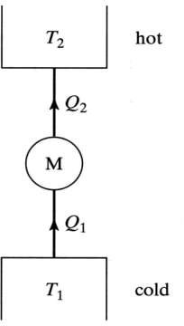
2ND LAW OF THERMODYNAMICS CLAUSIUS STATEMENT
CONCEPT
STATEMENT
It is impossible to construct a machine which operates in cycle whose sole effect is to transfer heat from LTB to HTB without consuming external work

Slide 44
2nd Law: Clausius and Kelvin Statements
22
Clausius statement (1850)
Heat cannot by itself pass from a colder to a hotter body; i.e. it is impossible to
Q₁ = Q₂ = Q
build a “perfect” refrigerator.
The hot bath gains entropy, the cold bath loses it.
ΔS_{univ}= Q₂/T₂ – Q₁/T₁ = Q/T₂ – Q/T₁ <
0.
M is not active.
Kelvin statement (1851)
No process can completely convert heat into work; i.e. it is impossible to build a “perfect” heat engine.
ΔS_{univ}= – Q/T < 0.
1st Law: one cannot get something for nothing (energy conservation).
2nd Law: one cannot even break-even (efficiency must be less

Slide 45
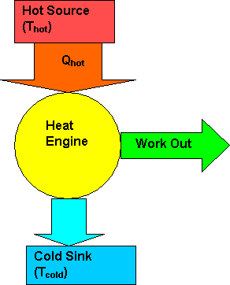
HEAT ENGINE
HEAT ENGINE
HEAT ENGINE
Thermodynamic system/Device which operate in cycle converts the heat into useful work.

Slide 46
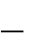
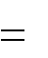
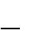
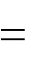
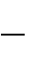
HEAT ENGINE
Efficiency = e = W/Qs
W
^{Q}hot ^{Q}cold
₁ ^{Q}cold
e
^{Q}hot ^{Q}hot
₁ ^{T}cold
^{Q}hot
e
Carnot
T
hot
Note: The temperatures must be measuredin Kelvins!!!

Slide 47



HEAT PUMP
Thermodynamic system/Device which operate in cycle converts the heat into useful work.
Hot Reservoir, T_{H}
Q_{H}
WORK
P
Q_{C}
Cold Reservoir, T_{C}

Slide 48






HEAT PUMP & REFRIGERATOR
HEAT PUMP
Hot Reservoir, T_{H}
Hot Reservoir, T_{H}
Q_{H}
Q_{H}
W
W
R
P
Q_{C}
Q_{C}
Cold Reservoir, T_{C}
Cold Reservoir, T_{C}

Slide 49
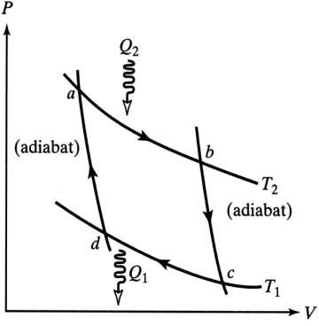
Reversible Engine: the Carnot Cycle
27
Stage 1 Isothermal expansion at temperature T₂, while the entropy rises from S₁ to S₂.
The heat entering the system is
Q₂ = T₂(S₂ – S₁).
Stage 2 adiabatic (isentropic) expansion at entropy S₂, while the temperature drops from T₂ to T₁.
Stage 3 Isothermal compression at temperature T₁, while the entropy drops from S₂ to S₁.
The heat leaving the system is
Q₁ = T₁(S₂ – S₁).
Stage 4 adiabatic (isentropic) compression at entropy S₁, while the temperature rises from T₁ to T2.
Since Q₁/Q₂ = T₁/T₂,
η = η_{r} = 1 – T₁/T₂.

Slide 50
Gibbs Free Energy
In thermodynamics, the Gibbs free energy is a thermodynamic potential that can be used to calculate the maximum of reversible work that may be performed by a thermodynamic system at a constant temperature and pressure. The Gibbs free energy is the maximum amount of non-expansion work that can be extracted from a thermodynamically closed system (can exchange heat and work with its surroundings, but not matter) in the standard state. This maximum can be attained only in a completely reversible process. When a system transforms reversibly from an initial state to a final state, the decrease in Gibbs free energy equals the work done by the system to its surroundings, minus the work of the pressure forces.

Slide 51
Gibbs Free Energy
The Gibbs free energy initially called available energy was developed in the 1870s by the American scientist Josiah Willard Gibbs.
The Gibbs Free Energy is also the thermodynamic potential minimized when a system reaches chemical equilibrium at constant pressure and temperature. Its derivative with respect to the reaction coordinate of the system vanishes at the equilibrium point. As a reduction in is necessary for a reaction to be spontaneous at constant pressure and temperature.
The initial state of the body, according to Gibbs, is supposed to be such that "the body can be made to pass from it to states of dissipated energy by reversible processes". In his 1876 magnum opus On the Equilibrium of Heterogeneous Substances, a graphical analysis of multi-phase chemical systems, he engaged his thoughts on chemical free energy in full.

Slide 52
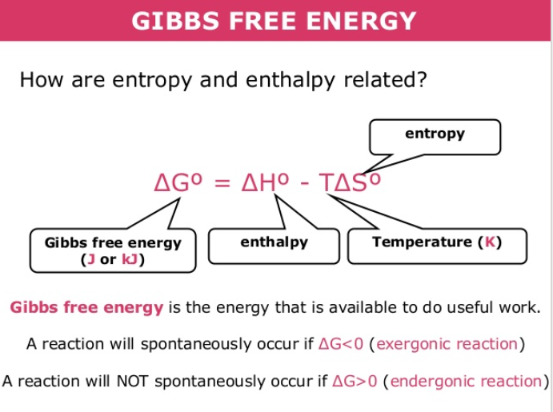

Slide 53
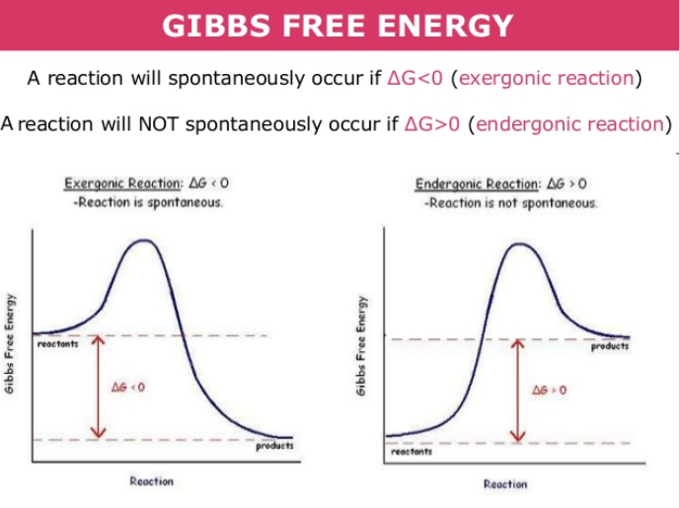

Slide 54
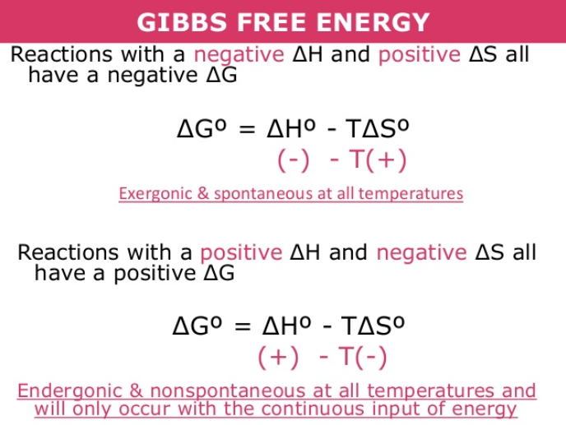

Slide 55
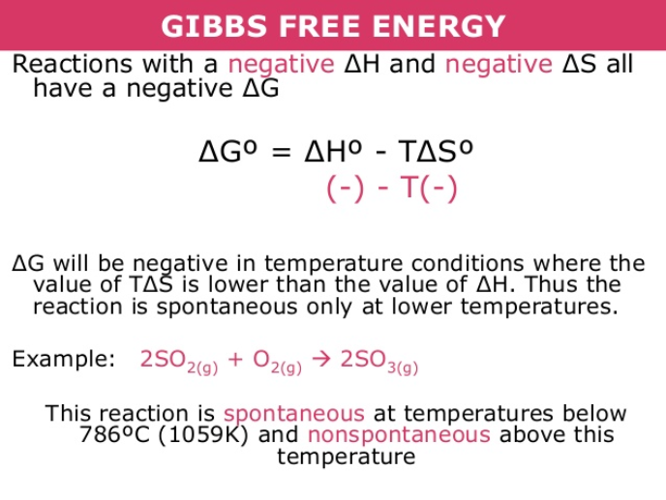

Slide 56
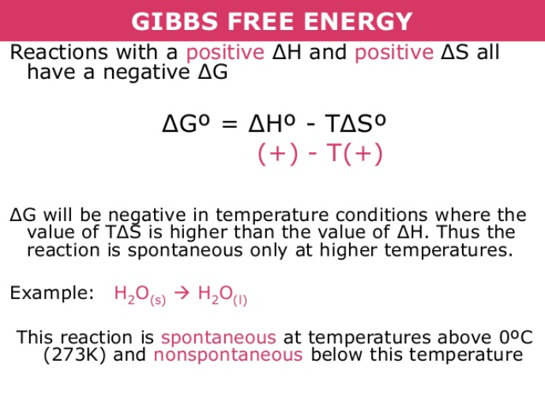

Slide 57
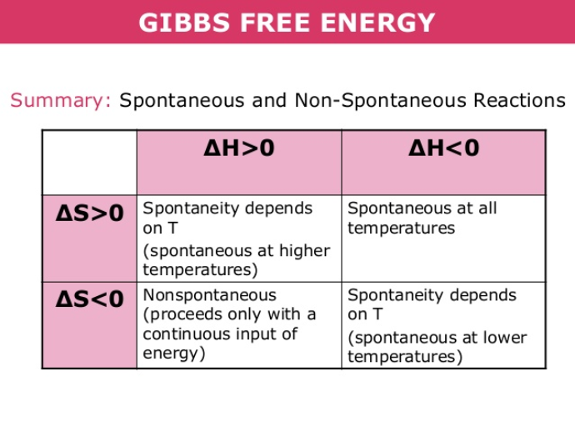

Slide 58


Slide 59


Slide 60

Gibbs Free Energy

Slide 61
Recall: ΔS_{univ} and Spontaneous Processes
The total entropy change of the universe (ΔS_{univ}) for any spontaneous process is positive.
^{+ ΔS}univ
^{ΔS}univ ^{= ΔS}sys ^{+ ΔS}surr

Slide 62
ΔS_{univ} and Gibbs Free Energy (G)
Calculating ΔS_{univ} is not convenient.
^{ΔS}univ ^{= ΔS}sys ^{+ ΔS}surr
Gibbs proposed a new thermodynamic state function that is derived from three other state functions for the system.
Enthalpy, Entropy, and Temperature.

Slide 63
Gibbs Free Energy (G)
G = H − TS
The Gibbs Free Energy change for a given process is
ΔG = ΔH − TΔS (at constant T and P)

Slide 64
ΔS_{univ} and Gibbs Free Energy (G)
Entropy S is maximized at equilibrium
Free energy G is minimized at equilibrium.

Slide 65
Gibbs Free Energy ΔG
Without derivation:
−TΔS_{univ} = ΔH_{sys} − T ΔS_{sys}
−TΔS_{univ} = ΔG
−ΔG
When ΔG for a given process is negative, the process is spontaneous in the forward direction (as written).

Slide 66
Predicting Spontaneity and ΔG
Negative ΔG means the process is spontaneous (as written; in the forward direction).
Positive ΔG means the process is nonspontaneous (as written). However, it is spontaneous in the reverse direction!
If ΔG = 0, the reaction is at equilibrium.

Slide 67
Gibbs Free Energy (G) and Predicting Spontaneous Processes
The sign of the Gibbs Free Energy for a given process will depend on the signs of
ΔH and ΔS.
ΔG = ΔH − T ΔS
We can predict whether a given process will b spontaneous by analyzing the signs of ΔH and ΔS.

Slide 68
ΔH, ΔS, and the Sign of ΔG
ΔG = ΔH − T ΔS
Sign of ΔH | Sign of ΔS | Sign of ΔG | Type of Process
negative | positive | negative | spontaneous at all temperatures
positive | negative | positive | nonspontaneous at all temperatures
positive | positive | (−) or (+) | Spontaneous if the temperature is high enough
negative | negative | (+) or (−) | Spontaneous if the temperature is low enough

Slide 69
Case 1: ΔH and ΔS Agree (Spontaneous)
When ΔH is negative and ΔS is positive, ΔG is always negative. The reaction is spontaneous in the forward direction (any T).
ΔG = ΔH − T ΔS
Negative term
ΔG = (−) − T (+)
T in K, so always a positive number!
ΔG = (−) − (+)(+)
ΔG = a negative number (any T)

Slide 70
Case 2: ΔH and ΔS Agree (Nonspontaneous)
ΔH is positive and ΔS is negative, so ΔG is always positive. The reaction is nonspontaneous in the forward direction (any T). Spontaneous in reverse direction.
ΔG = ΔH − T ΔS
Positive term
ΔG = (+) − T (−)
T in K, so always a positive number!
ΔG = (+) − (+)(−)
ΔG = a positive number (any T)

Slide 71
Case 3: ΔH and ΔS Disagree (ΔG “Decides”)
ΔH is positive and ΔS is positive, so ΔG is negative or positive depending on the temperature. The reaction is spontaneous in the forward direction if T is high enough.
ΔG = ΔH − T ΔS
ΔG = (+) − T (+)
Positive term
T in K, so always a positive number!
ΔG = (+) − (+)(+)

Slide 72
Case 3: ΔH and ΔS Disagree (ΔG “Decides”)
The reaction is spontaneous in the forward direction if T is high enough.
ΔG = ΔH − T ΔS
ΔG = (+) − T (+)
Subtract a large positive term
ΔG = (+) − (+)(+)
If T is high, subtract a larger number than ΔH
ΔG = a positive number (at low T)
ΔG = a negative number (at high T)

Slide 73
Case 4: ΔH and ΔS Disagree (ΔG “Decides”)
ΔH is negative and ΔS is negative, so ΔG is negative or positive depending on the temperature. The reaction is spontaneous in the forward direction if T is low enough.
ΔG = ΔH − T ΔS
ΔG = (−) − T (−)
negative term
T in K, so always a positive number!
ΔG = (−) − (+)(−)

Slide 74
Case 4: ΔH and ΔS Disagree (ΔG “Decides”)
The reaction is spontaneous in the forward direction if T is low enough.
ΔG = ΔH − T ΔS
a positive term
overall
ΔG = (−) − T (−)
ΔG = (−) − (+)(−)
If T is low, add a smaller number than ΔH
ΔG = a negative number (at low T)
ΔG = a positive number (at high T)

Slide 75
Summary: Gibbs Free Energy (G)
ΔG = ΔH − T ΔS
When ΔH is (−) and ΔS is (+) , ΔG is always (−). Spontaneous in the forward direction (any T).
ΔH is (+) and ΔS is (−), so ΔG is always (+). Nonspontaneous in the forward direction (any T).

Slide 76
Summary: Gibbs Free Energy (G)
ΔG = ΔH − T ΔS
ΔH is (+) and ΔS is (+), so ΔG is (−) or (+) depending on the temperature.
Spontaneous in the forward direction if T is high enough.

Slide 77
Summary: Gibbs Free Energy (G)
ΔG = ΔH − T ΔS
ΔH is (−) and ΔS is (−), so ΔG is (+) or (−) depending on the temperature.
Spontaneous in the forward direction if T is low enough.

Slide 78

End of Lecture 2

